Slide 1
The Fantastic Four: UB Arena Billing/Vendor Information
Fabricated by
Scott Sommavilla
Mario Urso
Mckenzie White
Chenyan Zou

Slide 2
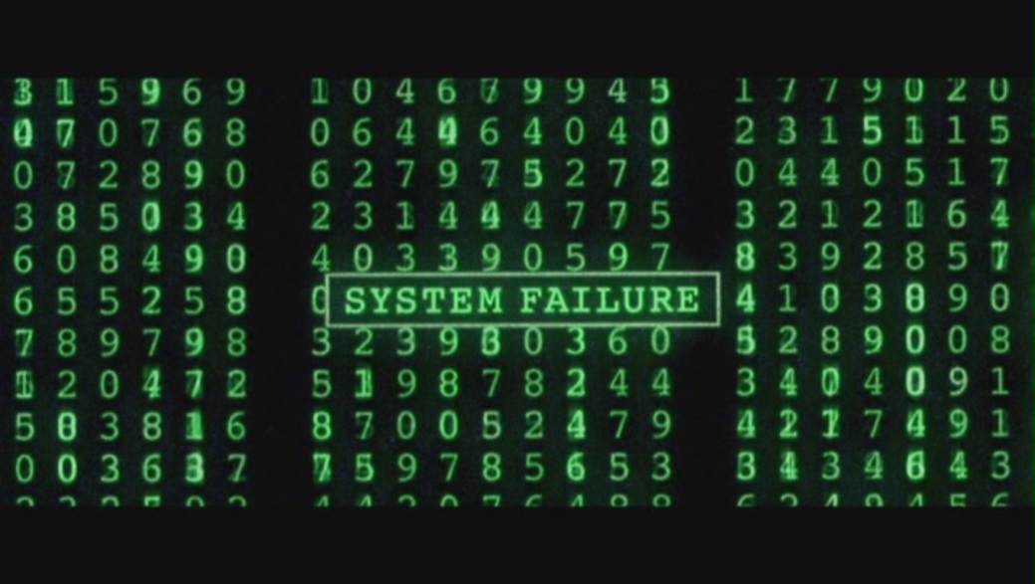
Why Build A Database?
Accurate and Accessible Data logging
Reliable accounting system
Eliminates Human Error

Slide 3
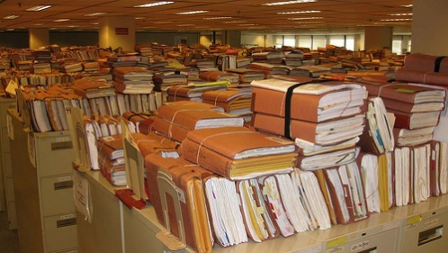
The Problem With Paper Systems
Easy to lose important data
Paper decay/fade due to age
Backing up documents takes significant amounts of space
Time consuming process

Slide 4
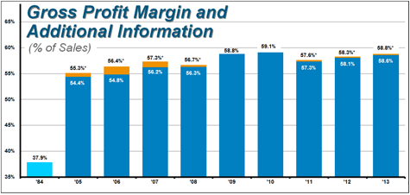
Reports
Payments by Month
Bills by Month
Vendors
Payment methods
Breakdown of Payments

Slide 5
Solutions
Ease of Use
Space Savings
Instantaneous Results
Time=Money

Slide 6
The Power of Access

